Slide 1
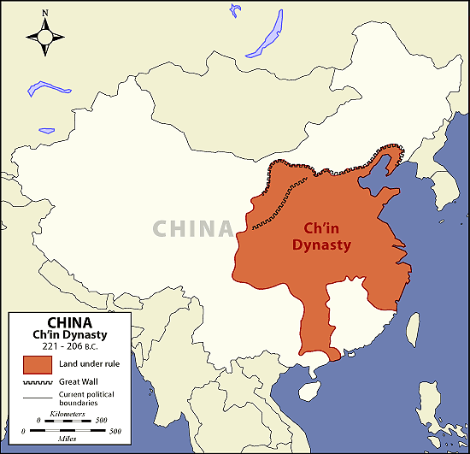
Focus: To what extent did opposing ideologies in Classical China attempt to bring social and political order?
Do Now: Read the following paragraph about Chinese philosophies.
In about 500 B.C., (interestingly, around the same time as Greek philosophy was emerging), the classic period of Chinese philosophy (known as the Contention of a Hundred Schools of Thought) flourished, and the three most influential schools (Confucianism, Taoism, and Legalism) were established.
Under what dynasty did the emergence of the philosophies occur?
Reminders:

Slide 2
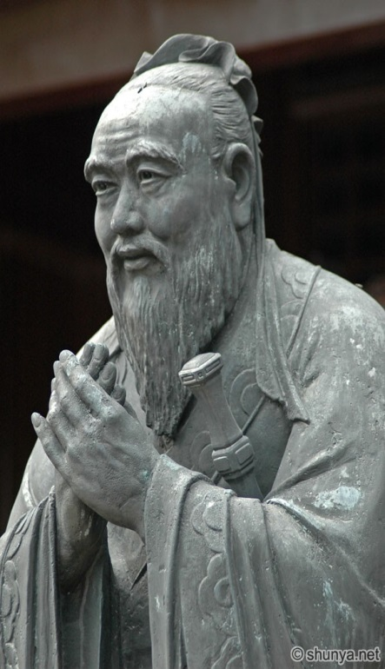
Confucius (孔夫子)
(551 B.C.E – 479 B.C.E)
Teachings were collected in THE ANALECTS
Filial Piety – respect for one’s parents and ancestors
People are inherently good and only require gentle guidance
Believed that there are 5 key relationships:
1. Ruler and subject
2. Father and son
3. Husband and wife
4. Oldest son and younger brothers
5. Friend to Friend
https://www.youtube.com/watch?v=wFt_VGG0kJU

Slide 3
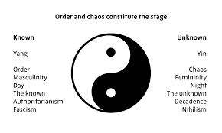
Laozi-Taoism (老子) ~6th – 4th Century BCE
Laozi, another Chinese philosopher who lived during the Zhou dynasty, looked at existence from a different perspective.
He believed that people needed to live close to nature and follow natural ways or the Tao, avoiding complexity and temporal distractions.
The universe has immutable characteristics which cannot be changed.
His philosophy is written in the Tao Te Ching!
Yin and Yang (阴阳 ): two forces, when in balance lead to peace and prosperity.
https://www.youtube.com/watch?v=kij4kKSGzCE

Slide 4
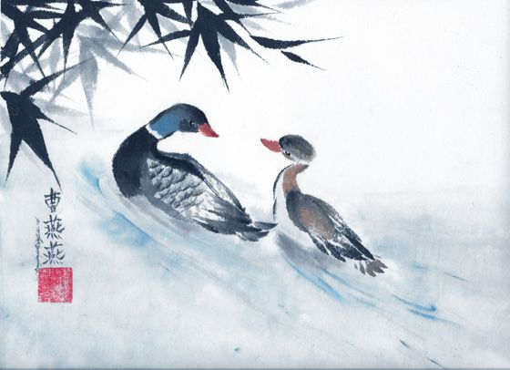
Focus: To what extent did opposing ideologies in Classical China attempt to bring social and political order?
A Daoist understands that a bird is not
a fish. A bird does not try to live in water.

Slide 5
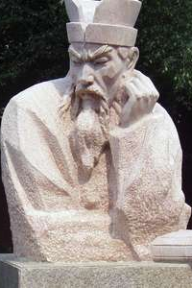
Shang Yang (商鞅) Han Fei Tzu (韓非) 4thand 3rd Century BCE
Legalism
Unlike Confucianism and Taoism, Legalists believed that people were inherently selfish and evil.
Due to their selfishness, wrongdoers had to be punished harshly by a tightly centralized government to prevent future transgressions.
The brutal implementation of this policy by the authoritarian Qin dynasty led to that dynasty’s overthrow and the discrediting of Legalist philosophy in China.
Though there are many legalist essays, the Han Feizi, named after the scholar, were the most influential.

Slide 6
Structure in Society
Guiding Question: What do each of these three famous Chinese philosophies say about structure in society?
Daoism --->
Confucianism --->
Legalism --->

Slide 7
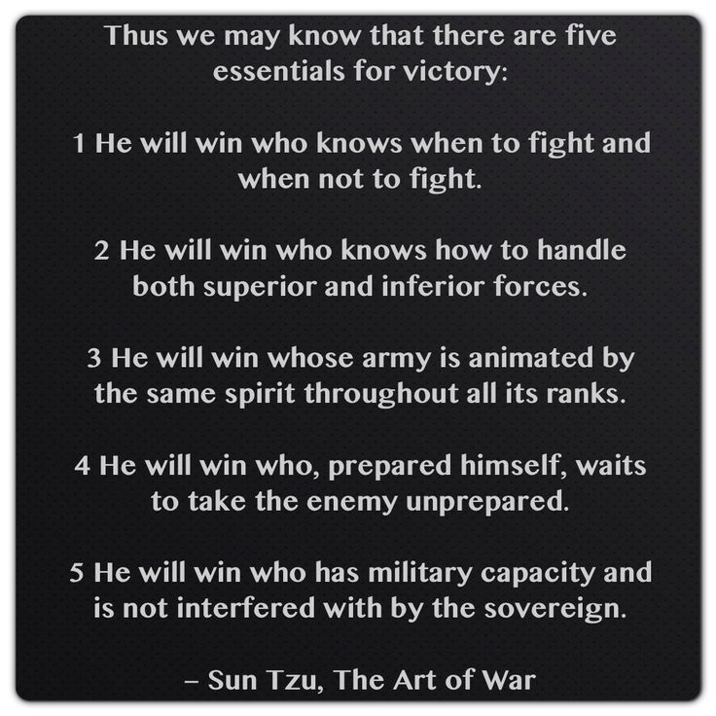
Art of War Stimulus Questions
Based on the excerpt, Sun Tzu would most likely agree with which of the following statements?
All men, women and children who oppose military rule should be executed.
Society was most effectively run by a decentralized tributary state.
Powerful emperors had the duty to conquer inferior barbaric peoples under the Mandate of Heaven.
Societies rulers rise to the top because of their leadership, strategy and virtue.

Slide 8
2. The detailed and intellectual nature of the Art of War proves that in Classical China…
A. Society focused on promoting religious tolerance.
B. Government was best run by theocratic emperors who were worshipped by the peasantry.
C. Soldiers deserved tax exemptions because of their faithful service to the emperor.
D. Many facets of society were organized by philosophical ideologies.
3. The sentiments of the previous passage connect most directly with what period of Chinese history ?
A. The Shang Dynasties practices of oracle bones and ancestor worship.
B. The Western Zhou’s decentralized feudal system.
C. The Period of the Warring States struggle over the Mandate of Heaven.
D. The implementation of legalist principles under the Qin Dynasty.

Slide 9
Group Activity: Open Document L4-Confucian & Daoist document on Google Classroom.
Aim: To what extent did opposing Ideologies in Ancient China attempt to bring social and political order?
Students will be broken into pairs. Each student will read and answer the questions from their document.
All students must (individually) respond in their notes.
Share your answers with your partners.

Slide 10
Confucian Questions:
Aim: To what extent did opposing Ideologies in Ancient China attempt to bring social and political order?
Daoist Questions:
What qualities and behaviors are emphasized by Confucius?
What is Confucius’ view of human nature?
According to the words of Confucius, how can order and stability be achieved in a society?
What is the Tao (Dao)? How is it described?
What quotes reflect the concept of Yin/Yang?
What qualities/behaviors are greatly valued by Daoist's?

